Slide 1
Electronic Voting System
Realized By :
Ahmed Mabrouk
Aicha Mnasser
Aymen Makhlouf
Med Amine Zaafouri

Slide 2
Summary :
Introduction
Feasibility Study
Data Model
Physical Architecture
Prototype
Conclusion

Slide 3

Introduction

Slide 4



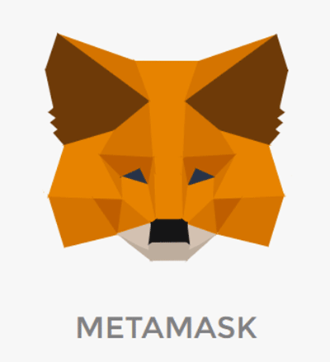

Feasibility Study

Slide 5
Data Model
Collection :
User
Collection : Private VoteSession
Collection :
VoteSession
[{
FirstName
Lastname
identityNumber
Nationality
birthday
Gender
Addresses [{
Street
City
ZipCode
}]
Email
Account
PrivateKey
}]
[{
Title
Date
Duration
Type
Candidates [{
User_id
}]
userConcerned[{
User_id
}]
}]
[{
Title
Date
Duration
Place
Candidates [{
User_id
}]
}]

Slide 6







Physical Architecture
Client APP
BlockChain
send privateKey
create account
authenticate
cast a vote
deployed
MetaMask Extension
buy token
BSON
verify
Smart contract

Slide 7
Prototype

Slide 8
Conclusion

